Slide 1

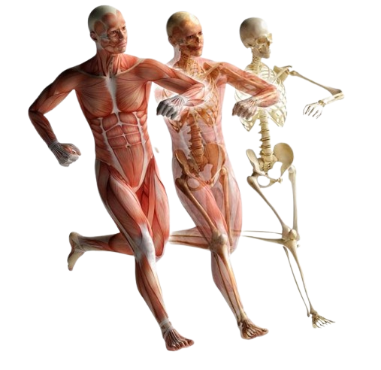
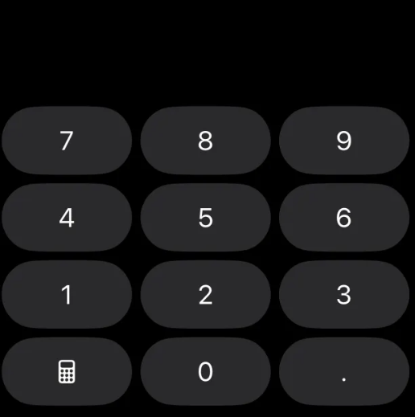

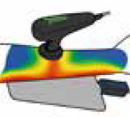
Endogenous Thermo Therapy
Transfer of
Energy
Capacitive
And
Resistive
TECAR Pro

Slide 2

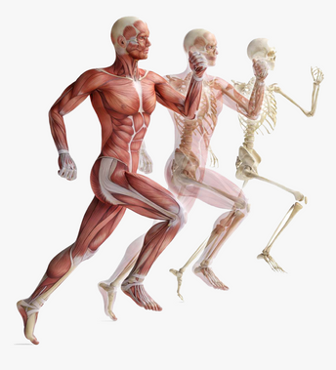



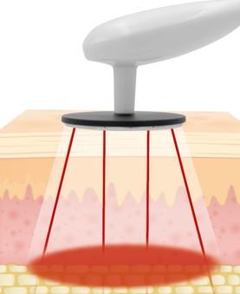

Endogenous Thermo Therapy
TECAR Pro
Volume | Brightness | Start-up
Protocol
Therapy

Slide 3
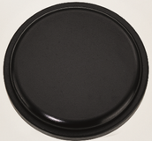
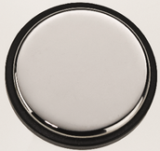






Endogenous Thermo Therapy
CAP | RES
 | On Sec Off Sec
1 MHz | 580KHz | 460KHz | 340KHz | Scan
Dermis | Muscles | Joints & Bones | Joints & Bones | Scan
Protocol
Therapy

Slide 4




Endogenous Thermo Therapy
CAP RES
 | On Sec Off Sec
HZ | 580KHz | Energy | 90 VA | Time
HZ
Protocol
Therapy

Slide 5
Endogenous Thermo Therapy
CAP RES
 | On Sec Off Sec
HZ | 580KHz | Energy | 20 VA | Time
HZ
Protocol
Therapy

Slide 6
Endogenous Thermo Therapy
CAP RES
 | On Sec Off Sec
HZ | 580KHz | Energy | 20 VA | Time
HZ
Protocol
Therapy

Slide 7
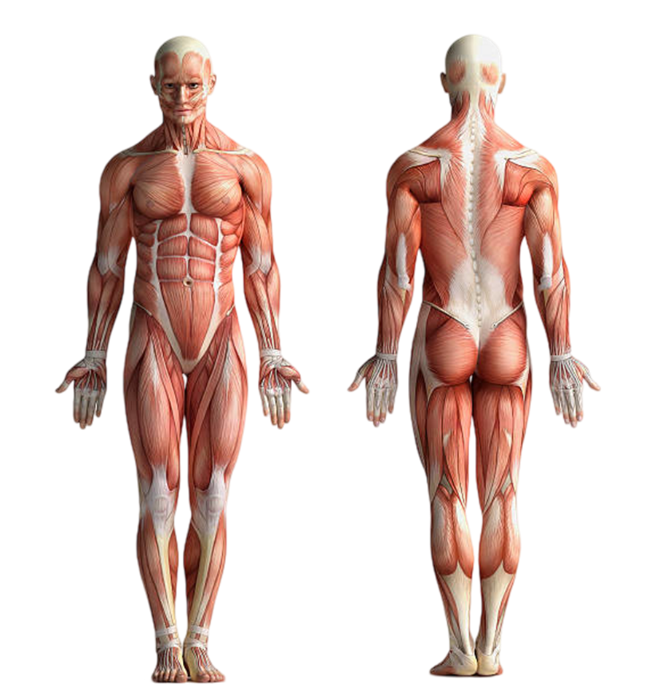
Endogenous Thermo Therapy
Cervical Spine
Shoulder
Elbow
Wrist
Low Back – Lumbar Spine
Hamstring – Muscular
Ankle
TMJ
Hip
Knee
Foot
Aesthetic

